Slide 1
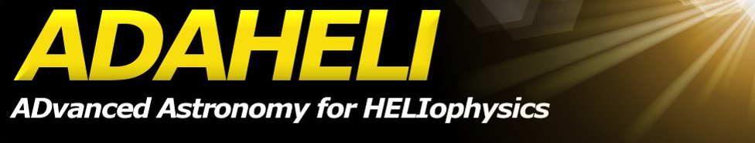





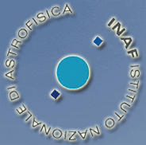

A Double Channel MOF Imager
to Study Low and Medium Oscillating Modes on-board ADAHELI
Moretti, P.F.(1,2); Berrilli, F. (2); Jefferies, S. M (3); Murphy, N.(4);
Velli, M.(4,5); Roselli, L. (6); Di Mauro, M.P. (7); Bigazzi, A.(2)
(1) CNR Department of Earth and Environment, P.le A. Moro, I-00185, Rome, Italy,
(2) Department of Physics, University of Rome Tor Vergata, I-00133, Rome, Italy,
(3) Institute for Astronomy, University of Hawaii, 4761 Lower Kula Road, Kula, Hawaii 96790, USA,
(4) Jet Propulsion Laboratory, m/s 169-506 4800 Oak Grove Drive, Pasadena, CA 91109, USA,
(5) Department of Astronomy and Space Sciences, University of Florence, Largo E. Fermi 2, 50125 Florence, Italy,
(6) Dip. di Ingegneria Elettronica e dell'Informazione, Universita` di Perugia, Italy,
(7) INAF - IASF, Istituto di Astrofisica Spaziale e Fisica Cosmica, via Fosso del Cavaliere 100, 00133 Roma, Italy

Slide 2
ADAHELI: why
ADAHELI, approved for Phase-A (feasibility study), is an Italian Space Agency (ASI) project for a mini-satellite-class Mission (around 400 Kg and a budget of 50 MEuros + launch, see http://adaheli.roma2.infn.it/adaheli_en/).
Main science goals
Photospheric and chromospheric dynamics and structure
Emergence, evolution and cancellation of solar magnetic features and solar irradiance
Chromospheric and corona heating and turbulence
Solar flares in the millimeter wavelength region
Augmented Science Objectives (Optional Instruments):
Helioseismology
Basic physics: solar gravitational red-shift
EUV variability of different solar features on the Sun and diagnostics of the extended solar corona.
Origin of ENA between terrestrial magnetosphere and geocorona

Slide 3
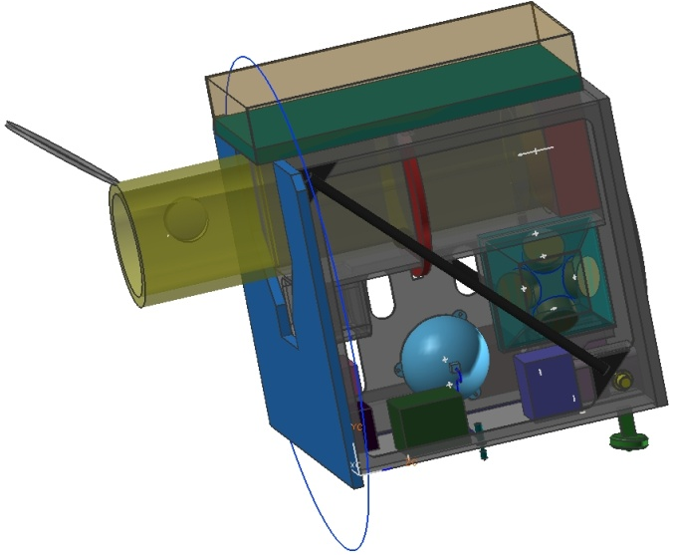
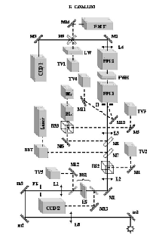
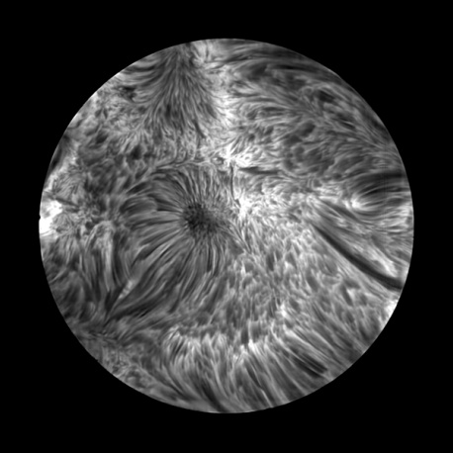
ADAHELI: how
Designed Mission Profiles for ADAHELI intend to achieve continuous high spectral and spatial resolution observations of the Sun for a routine duration of 4 hours with a goal to be extended to 24 hours.
IBIS: 854.2 nm Ca II Core
The principal Science instrument is a 40 cm solar telescope equipped with an innovative focal plane suite (ISODY) composed of a spectro-polarimetric imager, based upon a Fabry-Perot interferometer operating in the NIR regions around 845nm, a broad band channel for high resolution imaging, and a correlation tracker used as image stabilization system.
ADAHELI also carries MIOS, a millimiter wave radiometer operating at around 90 GHz for flare detection.

Slide 4
The Sun: what we know and what we do not.
From the observational point of view:
Long duration data sets
Bison, Iris, Gong, Ton, SOI/MDI, Virgo, Golf, etc.
Full-disk or integrated light,
low spatial resolution (> 2 arcsec),
Photosphere/ low chromosphere,
≈ 1 minute temporal acquisition.
Short duration data sets
Limited areas on solar disk,
low or high spatial resolution,
Photosphere, chromosphere, corona,
higher temporal acquisition.
The dream
Technology…money…
Multi-height, multi-parameter, simultaneous,
full-disk @ high resolution, long-term @ high temporal cadence
The reality:
MOTH @ South Pole 2008
Multi-height, multi-parameter, simultaneous,
full-disk , high temporal cadence

Slide 5
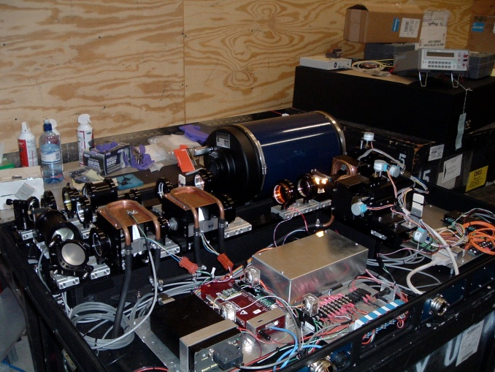
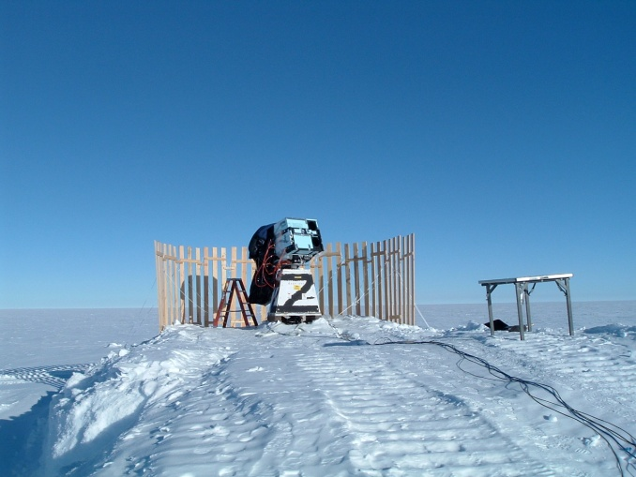
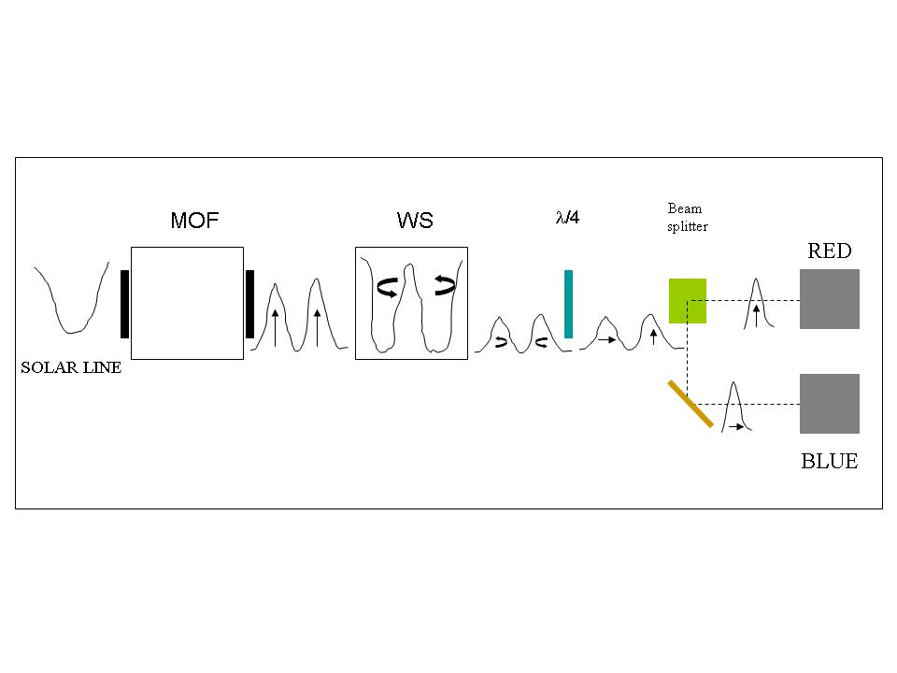
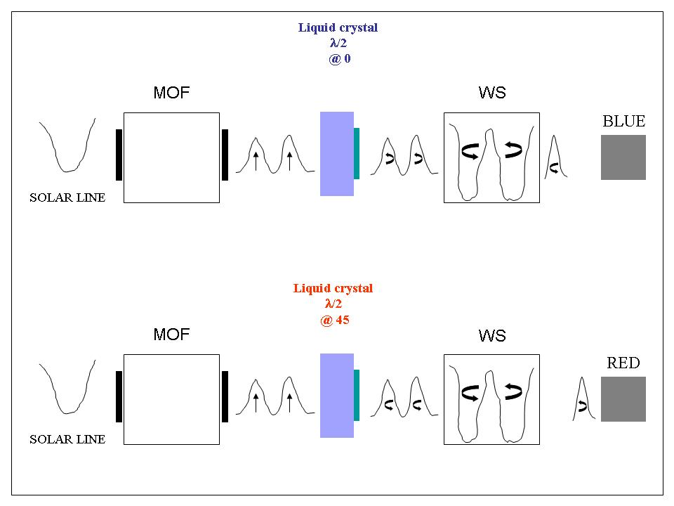
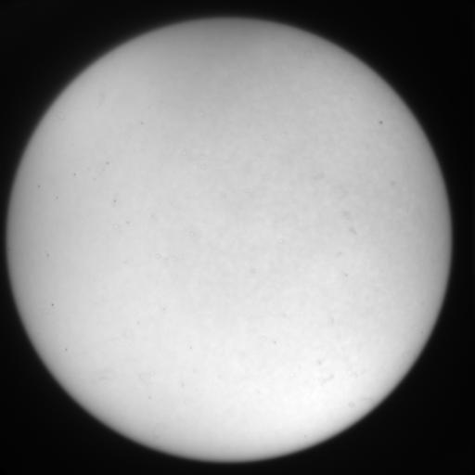
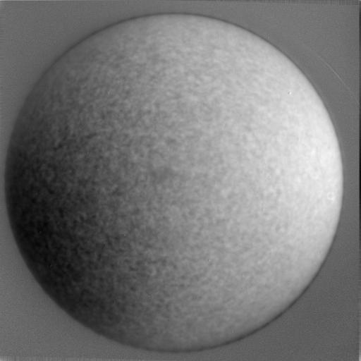
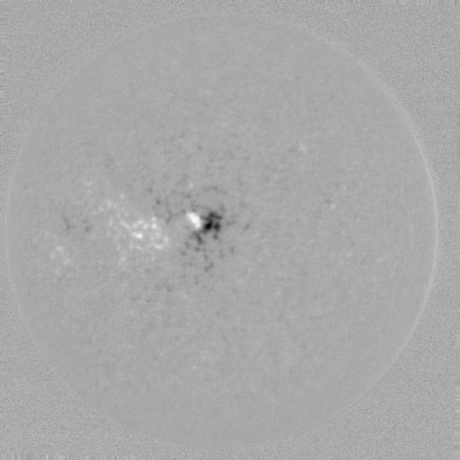
What is the MOTH:
K & Na MOFs simultaneous I, V, B
Full-disk @ 4 arcsec
5 s cadence
Magneto-Optical Filter:
internal wavelength reference, narrow passband, imaging capability.
Two cameras for each line,
Blue and Red images acquired simultaneously,
registration between images needed,
magnetic signal selected at the entrance through a fast modulation of the polarization
One camera for each line,
Blue and Red images acquired successively with fast modulation of the polarization,
No registration between images needed,
magnetic signal selected at the entrance through a fast modulation of the polarization.

Slide 6
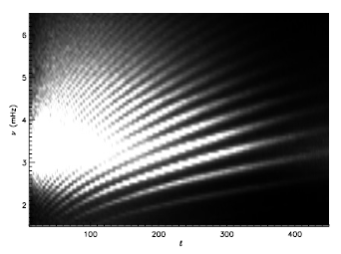
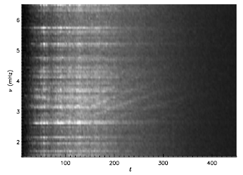
Performances (1): the l-ν diagram of the magnetic signal
Moretti et al. 2003, “Full-disk magnetic oscillation in the solar photosphere”, A&A, 403, 297-302
The l-ν diagrams for the velocity power (left), longitudinal magnetic field power (center) and coherence between them (right).
They have been obtained from only 256 images acquired each minute on the sodium D lines.
Scales from black to white correspond to from zero to 10⁻⁴ (m/s) ²/Hz, from zero to 4 10⁻⁸ (G)²/Hz and from zero to 0.2 respectively.
The instruments based on MOFs, thanks to the stability of the reference wavelengths, are the sole, to date, whose data permitted the description of the global magnetic field through the l-ν diagram .

Slide 7
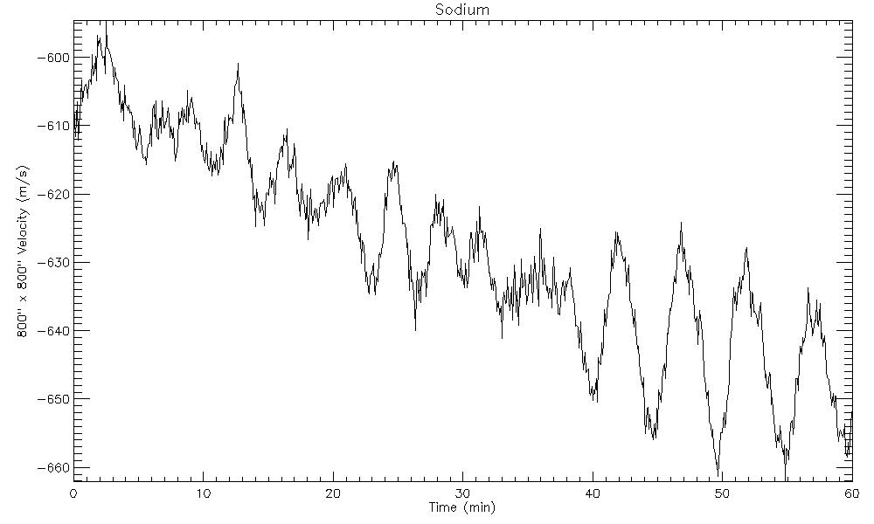
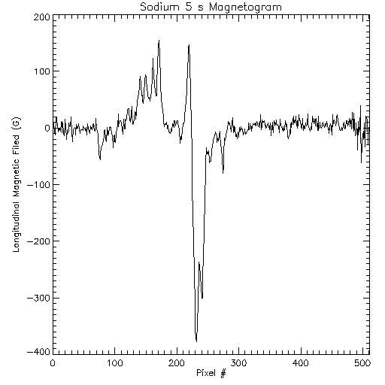
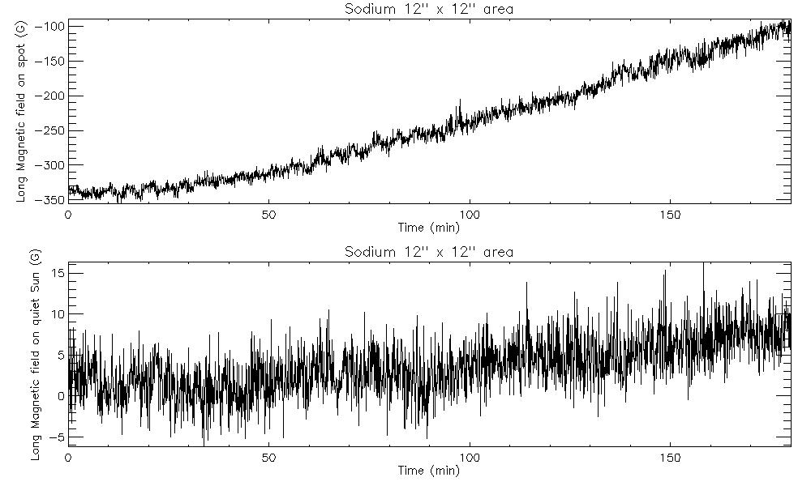
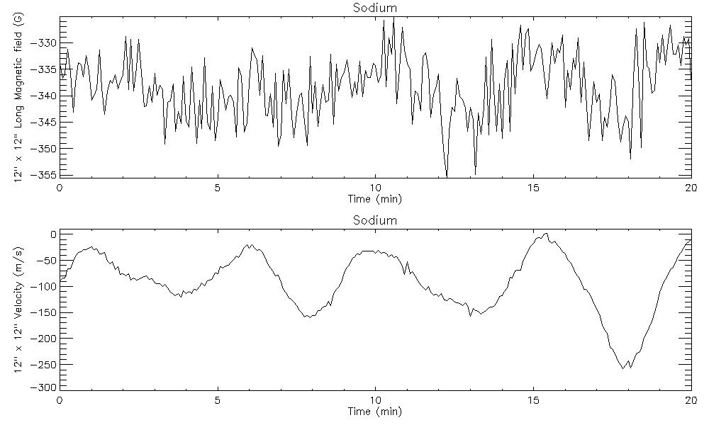
Performances (2): high frequency spectrum and not only…
5s longitudinal magnetogram
Feb 2nd 2008
Scan of the magnetic signal along a raw
Timeseries of the disk center velocity
integrated over 800” x 800”
5 G
Magnetic signal timeseries of 12” x 12” area
on a spot (top) and a quiet (bottom) region
Magnetic (top) and Velocity (bottom) timeseries of 12” x 12” area on a spot region

Slide 8
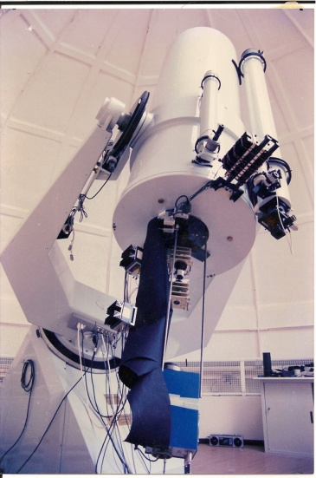
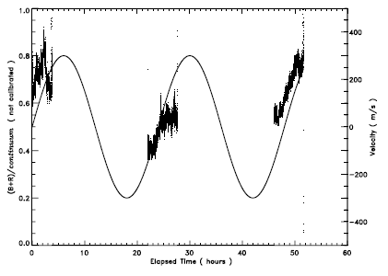
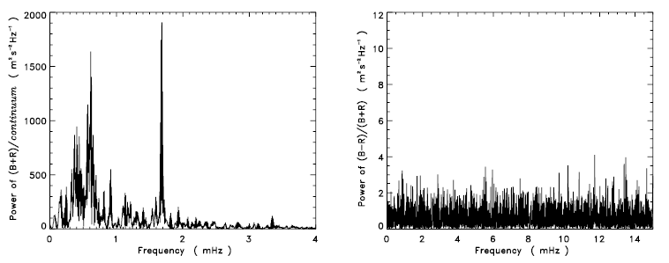
Performances (3): stellar seismology
Cacciani et al. 2001, “Search for global oscillations on Jupiter
with a double-cell sodium magneto-optical filter”, A&A, 372, 317-325
The signal vs time
@ Teramo Observatory
The power (intensity and velocity) vs frequency

Slide 9
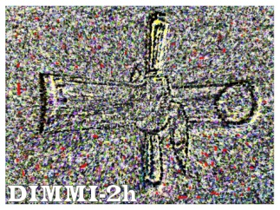
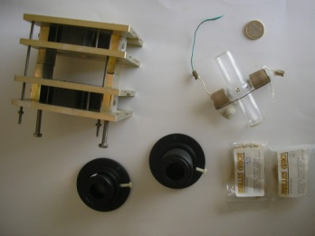
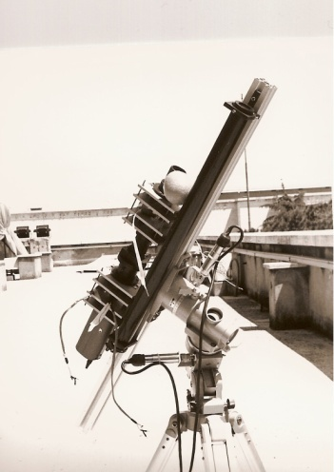
DIMMI-2h (Optional Instrument on ADAHELI)
Doppler-Intensity-Magnetograms with a Magneto-optical filter Instrument at two heights
~ 30 cm
10 cm
λ/4
2 cm
λ/4
10 Å prefilter
CCD
Electro-optical
MAG modulator
MOF
Electro-optical
DOP modulator
WS
Let’s fly it!
Compactness (< 1 m)
Weight (< 20 Kg)
K & Na MOFs
simultaneous I, V, B
Full-disk @ 8 arcsec
15 s cadence

Slide 10
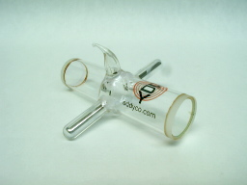
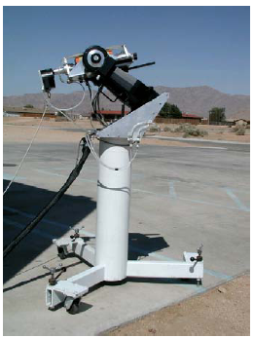
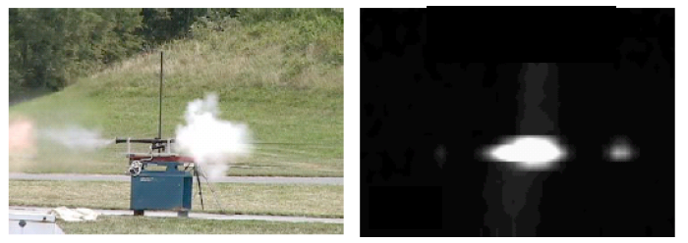
Solved Contra: no more “hand-made” MOFs
Industrial production of the K & Na cells
Development of Ca and He cells
“Fire-eye” application

Slide 11
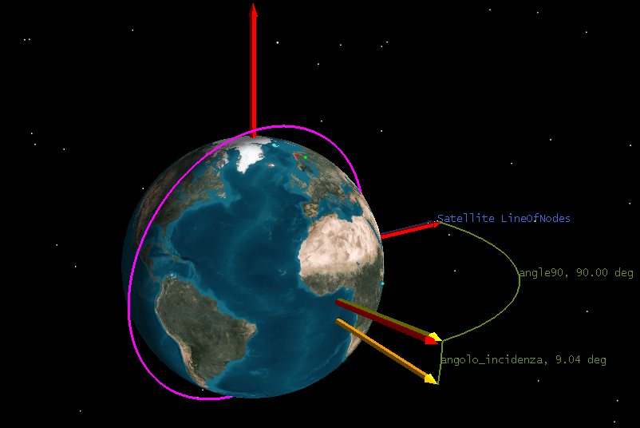
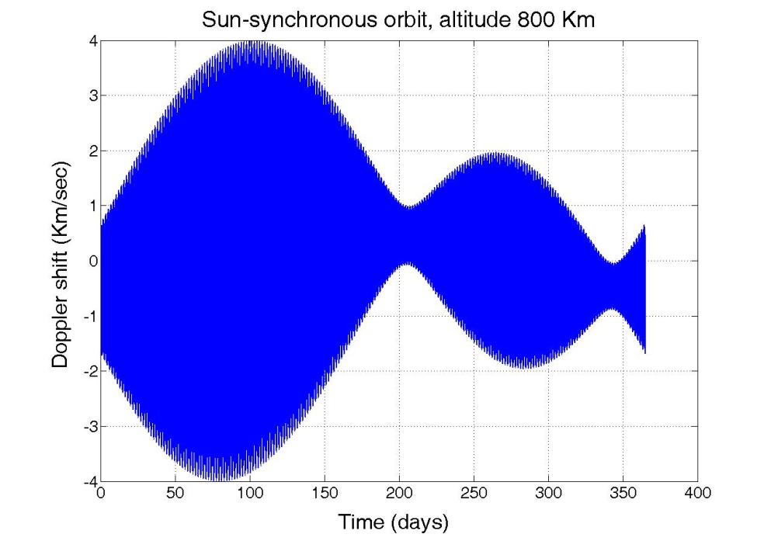
Reported contra: usually only two points on the line.
Correct knowledge of the tuning of wavelengths
Calibration
In principle, more points can be added
Range of utilization
Cacciani, A. Moretti, P.F., Papaldo, D. and Paverani, E., 1993, Solar Phys., 144, 205, The Stark effect as a calibration tool in helioseismology
Cacciani, A. and Moretti, P.F. 1997, Solar Physics, 175, 1, Magnetic Contamination and Correction in Sodium Dopplergrams
Moretti, P.F. and the MOF Development Group, 2000, Solar Phys., 196, 51, Dopplergrams Calibration
Moretti, P.F. 2000, Solar Phys., 196, 299, Can dopplergrams be corrected for straylight?
Moretti, P.F. and Severino, G. 2002, Astron. & Astroph., 384, 638, The I-V phase difference with Magneto-Optical Filters
Moretti, P.F. and Severino, G. 2004, Astron. & Astroph., 421, 729, A model to interpret the I-V and V-V phase differences from solar observations obtained with magneto-optical filters
Magrì, M., Oliviero, M. and Severino, G., 2005, Solar Phys., 232, 159, An Observational Method to Prevent Cross-Talk and Calibrate Mof-Based Instruments
0.02 nm

Slide 12
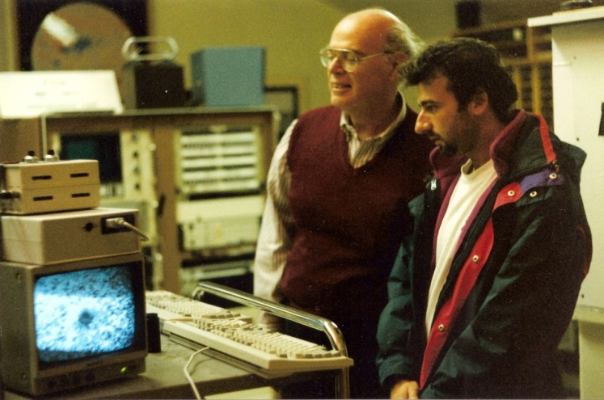
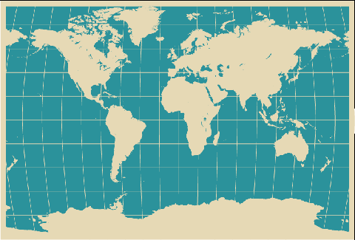
MOFs in the world, in the past and the present:
A. Cacciani, E. Rhodes, S. Tomczyk, E. Fossat, The Kanzelhohe Solar Observatory Group, M. Messerotti,
M. Dolci, G. Severino, M. Oliviero, M. Bianda, S.M. Jefferies, N. Murphy, W. Rodgers……
Main MOF’s related references
Cimino, M., Cacciani, A. and Fofi, M. 1970, Solar Physics, 11, 319, Some Developments of the Magnetic Beam Absorption Filter
Agnelli, G., Cacciani, A. and Fofi, M. 1975, Solar Physics, 44, 509, The magneto-optical filter. I - Preliminary observations in Na D lines
Rhodes, E. J. et al. Advances in Space Research, 4, 103, A compact dopplergraph/magnetograph suitable for space-based measurements of solar oscillations and magnetic fields
Rhodes, E. J. et al., 1984, Solar Seismology from Space, A Conference at Snowmass, Colorado, JPL Publication 84/84, 125, Evaluation of a Magneto-Optical Filter and a Fabry-Perot Interferometer for the Measurement of Solar Velocity Fields from Space
Tomczyk et al. 1984, Bulletin of the American Astronomical Society, 16, 978, The Summer 1984 Solar Oscillation Program of the Mount Wilson 60-foot Solar Telescope
Rhodes et al. 1984, Bulletin of the American Astronomical Society, 16, 979, Observations of Solar Velocity Fields With Large-Format CCD Cameras at the Mount Wilson Observatory
Rhodes, E.J, Cacciani, A. and Tomczyk, S. 1986, in : The internal solar angular velocity: Theory, observations and relationship to solar magnetic fields; Proceedings of the Eighth Summer Symposium Sunspot, Dordrecht, D. Reidel Publishing Co., 69, Full-disk solar Dopplergrams observed with a one-megapixel CCD camera and a sodium magneto-optical filter
Rhodes, E.J. et al. 1988, The Astrophysical Journal, 326, 479-485, On the constancy of intermediate-degree p-mode frequencies during the declining phase of solar cycle 21
Cacciani, A. et al. 1988, In ESA pub.: Seismology of the Sun and Sun-Like Stars,185, Acquisition and reduction procedures for MOF Doppler-magnetograms
Cacciani, A. et al. 1991, JPL report
Tomczyk, S., Cacciani, A. and Veitzer, S. A 1993, GONG 1992. Seismic Investigation of the Sun and Stars. Proceedings of a Conference held in Boulder, Colorado Editor, Timothy M. Brown; Publisher, Astronomical Society of the Pacific #42, 469, LOWL - an Instrument to Observe Low-Degree Solar Oscillations
Cacciani, A. Moretti, P.F., Papaldo, D. and Paverani, E., 1993, Solar Phys., 144, 205, The Stark effect as a calibration tool in helioseismology
Cacciani, A. and Moretti, P.F. 1994, Proc. SPIE 2198, 219, Instrumentation in Astronomy VIII, David L. Crawford; Eric R. Craine; Eds., Magneto-optical filter: concept and applications in astronomy
Cacciani, A., Moretti, P. F. and Smith, E.J. 1995, Astronomical Society of the Pacific Conference Series, GONG 1994: Helio- and Astero-Seismology from the Earth and Space. Eds. Roger K. Ulrich, Edward J. Rhodes, Jr., Werner Dappen; Publisher, Astronomical Society of the Pacific, 76, 440, Evaluation of a Portable and Inexpensive MOF Unit for Doppler Imaging
Cacciani, A., Moretti, P.F., Dolci, M., Brucato, E. and Smith, E.J. 1995, Geophys. Res. Lett., 22, 2437, Doppler observations of the impact of Comet P/ Shoemaker-Levy/9, fragment A
Cacciani, A. and Moretti, P.F. 1996, Bull. Am. Astron. Soc., Vol. 28, No. 3, 1193, Magnetic contamination on integrated disk Doppler data (GOLF): a procedure to correct it
Cacciani, A., Moretti, P.F. and Rodgers, W.E. 1997, Solar Physics, 174, 115, Measuring Doppler and Magnetic Fields Simultaneously
Cacciani, A. and Moretti, P.F. 1997, Solar Physics, 175, 1, Magnetic Contamination and Correction in Sodium Dopplergrams
Cacciani, A. et al. 1998, Second Advances in Solar Physics Euroconference: Three-dimensional structure of solar active regions, ASP Conf. Ser., Eds.: C.E. Alissandrakis & B. Schmieder, 155, 265, A MOF-based full vector imaging magnetograph
Oliviero, M. et al. 1998, International Astronomical Union. Symposium: New Eyes to See Inside the Sun and Stars, Eds. Franz-Ludwig Deubner, Joergen Christensen-Dalsgaard, and Don Kurtz, 185, 53, VAMOS: Velocity and Magnetic Observations of the Sun
Cacciani, A. et al. 1999, Motions in the Solar Atmosphere, Eds. Arnold Hanslmeier and Mauro Messerotti, Kluwer Academic Publishers, Dordrecht/Boston/London, Astrophysics and Space Science Library, 239, 271, The Magneto-Optical Filter at Kanzelhöhe
Moretti, P.F., and the MOF Development Group, 2000, Solar Phys., 196, 51, Dopplergrams Calibration
Moretti, P.F. 2000, Solar Phys., 196, 299, Can dopplergrams be corrected for straylight?
Warmuth, A., Hanslmeier, A., Messerotti, M., Cacciani, A., Moretti, P.F., Otruba, W. 2000, Solar Physics, 194, 103, NOAA AR 8210: Evolution and Flares from Multiband Diagnostics
Cacciani et al. 2001, A&A, 372, 317, Search for global oscillations on Jupiter with a double-cell sodium magneto-optical filter
Moretti, P.F., Cacciani, A., Hanslmeier, A., Messerotti, M., Oliviero, M., Otruba, W., Severino, G. and Warmuth, A. 2001, Astron. & Astroph., 372, 1038, The source of the solar oscillations: magnetic or convective?
Moretti, P.F. and Severino, G. 2002, Astron. & Astroph., 384, 638, The I-V phase difference with Magneto-Optical Filters
Oliviero, M. , Moretti, P.F., Severino, G., Straus, Th., Magri, M., Tripicchio, A. 2002, Solar Phys., 209, 21, Preliminary Results on the Solar Photospheric Dynamics Observed with Vamos
Moretti, P.F., Cacciani, A., Hanslmeier, A., Messerotti, M., Otruba, W. and Warmuth, A. 2002, Astron. & Astroph., 395, 293, An interpretation of the I-V phase background based on observed plasma jets
Moretti, P.F., Cacciani, A., Hanslmeier, A., Messerotti, M., Otruba, W. and Warmuth, A 2003, Astron. & Astroph, 403, 297, Full-disk magnetic oscillations in the solar photosphere
Moretti, P.F. and Severino, G. 2004, Astron. & Astroph., 421, 729, A model to interpret the I-V and V-V phase differences from solar observations obtained with magneto-optical filters
Finsterle, W., Jefferies, S.M., Cacciani, A., Rapex, P., Giebink, C., Knox, A. and Dimartino, V. 2004, Proceedings of the SOHO 14 / GONG 2004 Workshop (ESA SP-559). Eds. D. Danesy., 223, Acoustic Waves Reveal the Magnetic Topology of the Solar Atmosphere
Finsterle, W., Jefferies, S.M., Cacciani, A., Rapex, P., Giebink, C., Knox, A. and Dimartino, V. 2004, Solar Physics, 220, 317, Seismology of the solar atmosphere
Finsterle, W., Jefferies, S.M., Cacciani, A., Rapex, P. and McIntosh, S.W. 2004, The Astrophysical Journal, 613, L185, Helioseismic Mapping of the Magnetic Canopy in the Solar Chromosphere
Magrì, M., Oliviero, M. and Severino, G., 2005, Solar Phys., 232, 159, An Observational Method to Prevent Cross-Talk and Calibrate Mof-Based Instruments
Cacciani, A. et al. 2005, EAS Publications Series, 14, 269, Diagnostic of the Solar Atmosphere through Two Level Doppler and Magnetic Measurements
Jefferies, S. M., Armstrong, J. D., Cacciani, A., Giebink, C. A., Rodgers, W. and Murphy, N. 2005, American Geophysical Union, Spring Meeting 2005, abstract #SH13C-12
A new Instrument for High-cadence, Multi-height Observations of the Velocity and Magnetic Fields of the Full Solar Disk
Rodgers, W., Murphy, N. and Jefferies, S. M. 2005, American Geophysical Union, Spring Meeting 2005, abstract #SH13C-13 , A Calcium-Based Magneto-Optical Filter
Jefferies, S. M. et al. 2006, The Astrophysical Journal, 648, L151-L155
Magnetoacoustic Portals and the Basal Heating of the Solar Chromosphere
Haberreiter, M., Finsterle, W. and Jefferies, S. M. 2007, Astronomische Nachrichten, 328, 211, On the observation of traveling acoustic waves in the solar atmosphere using a magneto-optical filter
Moretti, P. F., Jefferies, S. M., Armstrong, J. D. and Mc Intosh, S. W. 2007, Astronomy and Astrophysics, 471, 961, Observational signatures of the interaction between acoustic waves and the solar magnetic canopy
Magrì, M., Oliviero, M. and Severino, G., 2008, Solar Phys., 247, 15, Accurate Intensity Velocity Phase Difference in the Potassium Resonance Line Obtained with VAMOS
Long-term imaging observations:
Mt Wilson (Ed Rhodes)
Mauna Loa (S. Tomczyk)
Kanzelhohe (P.F. Moretti, Th. Pettauer,
A. Hanselmeier, M. Messerotti)
Long-term non-imaging observations:
IRIS network (E. Fossat)
Observing imaging campaigns:
Naples (G. Severino, M. Oliviero)
Kitt Peak (P.F. Moretti)
South Pole (S.M. Jefferies)
Rome (P.F. Moretti)
Observing non-imaging campaigns:
Terra Nova Bay (P.F. Moretti, M. Dolci)
Stellar non-imaging observations:
Teramo (M. Dolci, P.F. Moretti)

Slide 13

Technology…money, what else?
At the moment, a double-height complete MOF based system for full-disk ground observations costs less than 100 K$!
Cells have flown on-board GOLF.
Stability and sensitivity of MOF based systems are much larger than other instruments.
Well-known labs, research groups and industries are involved in the development of the system.
…..

